Slide 1

Vidyavardhini’s College of Engineering and Technology
Department of Computer Engineering

Slide 2
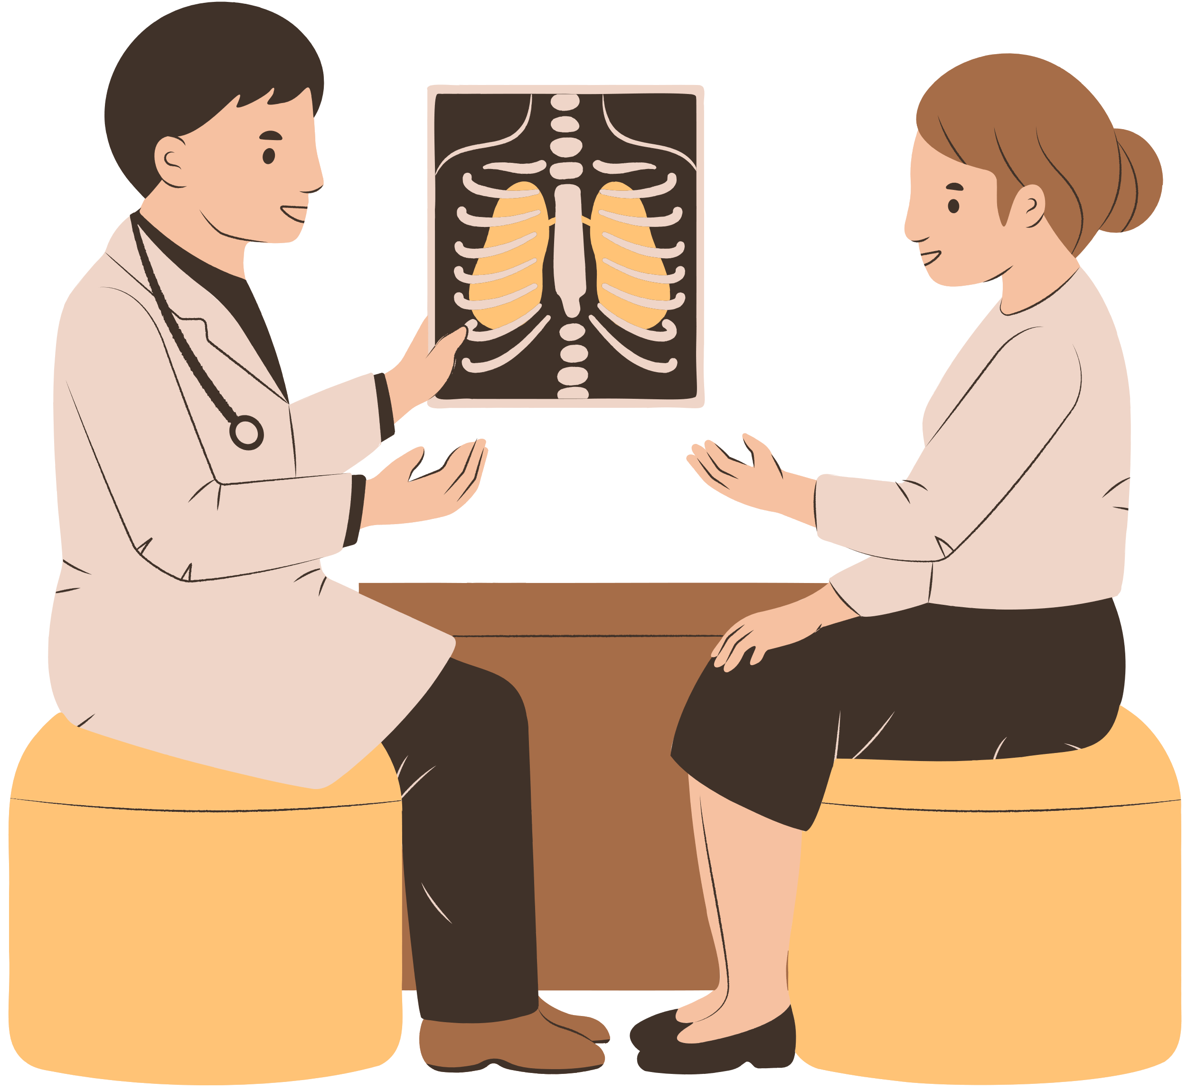
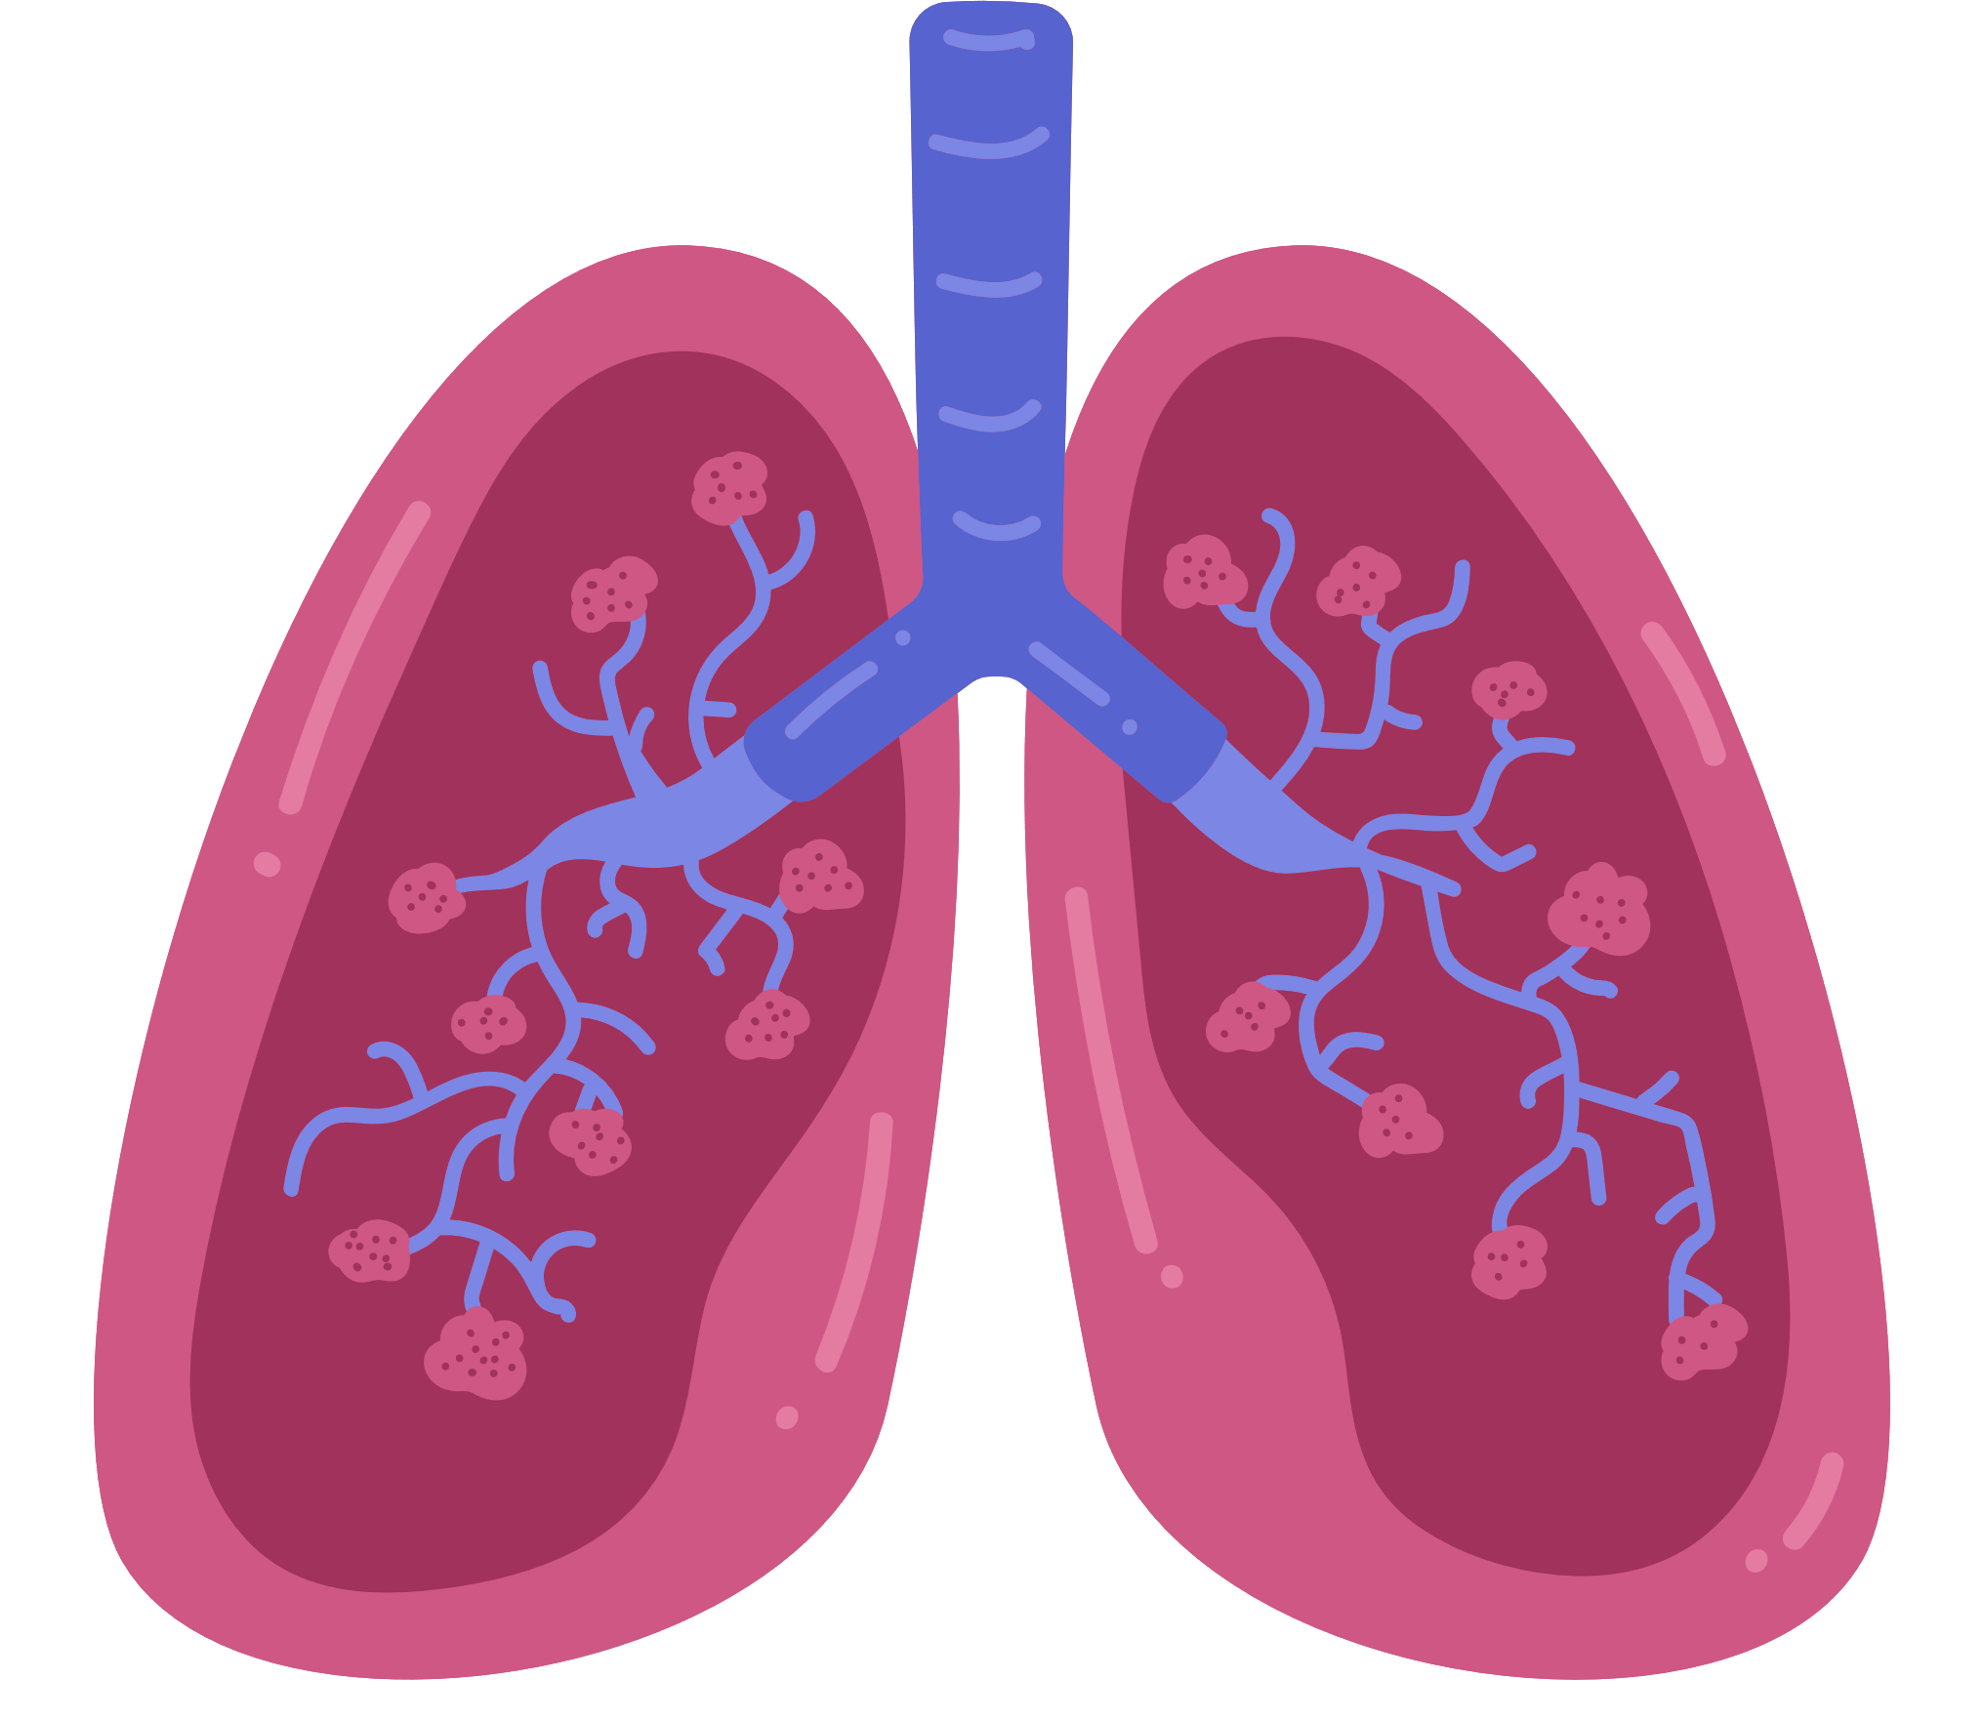
Lung Cancer Detection
Guide:-
Dr. Megha Trivedi
Team Members:-
22_Prerna Gawali
36_Onkar Suryavanshi
37_Raj Sutar

Slide 3
Introduction
Cancer is the root cause for a large number of deaths worldwide, out of which lung cancer is the cause of the highest mortality rates.
Computer tomography scan is employed by radiologists to detect cancer in the
body and track its growth.
Visual interpretation of database can lead to cancer detection at later stages, thus leading to late treatment of cancer which only boosts up the cancer death rates.
Therefore, image processing tools can be used for early detection of cancer.
In this paper, a lung cancer detection algorithm is proposed using mathematical morphological operations for segmentation of the lung region of interest, from which Haralick features are extracted and used for classification of cancer by neural networks.

Slide 4

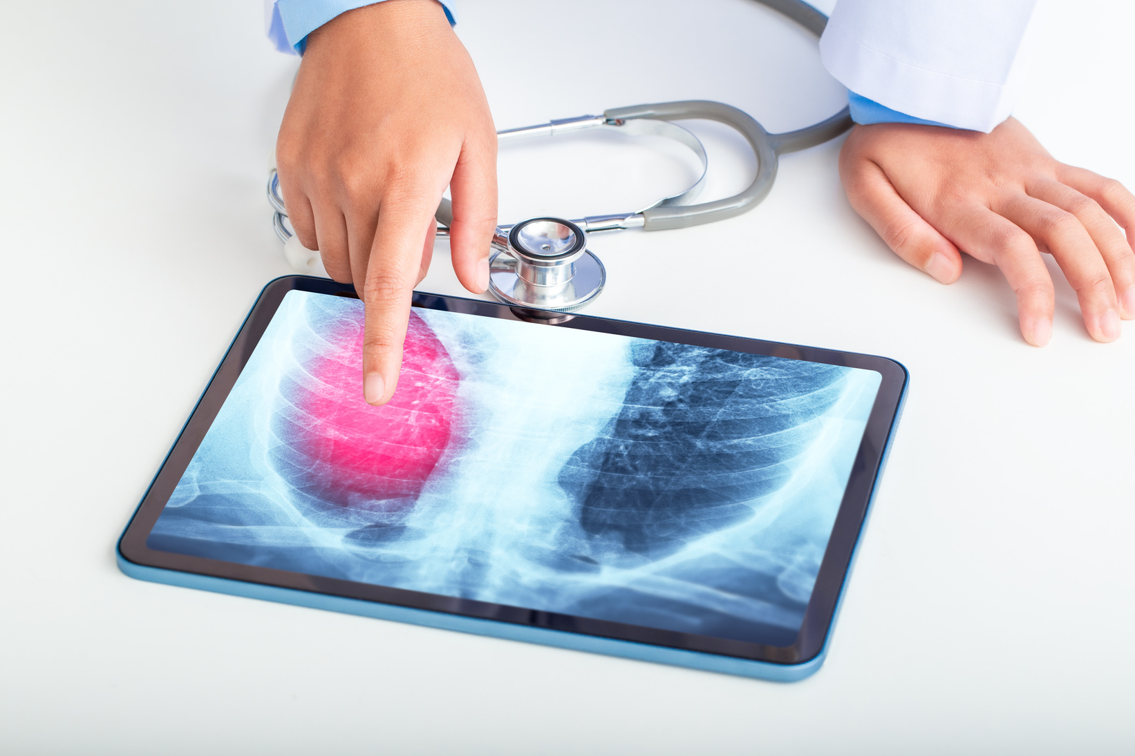
Problem Statement
To develop and implement a system for the early detection of lung cancer.

Slide 5
Abstract
This study introduces a cutting-edge methodology for lung cancer detection
by integrating Computed Tomography (CT) scan images and Convolutional Neural Network (CNN) algorithm. Leveraging the strengths of high-resolution CT scans and the learning capabilities of CNNs, our approach strives for increased accuracy in identifying early-stage lung cancer. The research includes preprocessing of CT and extensive CNN model training, and thorough performance evaluation. The ultimate goal is to provide a robust and efficient tool for early diagnosis, potentially transforming the landscape of lung cancer detection and improving patient outcomes.

Slide 6






Technologies Used
Python
Deep Learning
HTML
CSS
CNN
VS Code

Slide 7
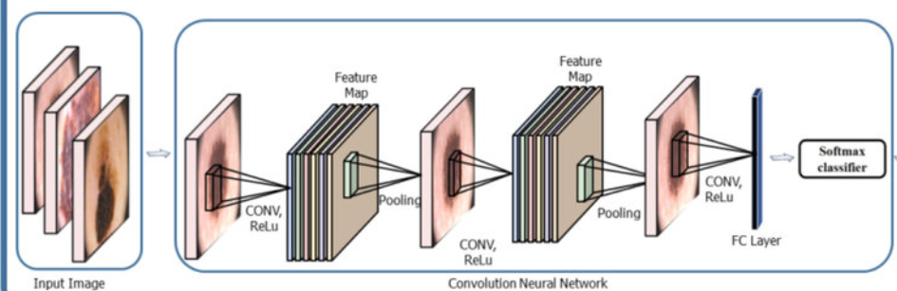
Block Diagram

Slide 8
Feature Extraction
In the initial layers, the convolutional filters typically capture low-level features like edges, corners, and textures.
As you go deeper the layers start combining low-level features to form mid-level features.
Further layers capture high-level features that are more complex and abstract.
The final layers of the network, particularly the fully connected layers, learn to combine these high-level features to make predictions
The following elements are considered for extracting the features in CNN algorithm:
Convolution layers: This layer applies a filter, also known as a kernel, to the image. The output of the convolution layer is a feature map, which is a new image that represents the detected patterns.
Pooling layers: . This reduces the size of the network and makes it more computationally efficient.
Fully connected layers: Fully connected layers are used at the end of the CNN to learn the relationship between the extracted features and the desired output.

Slide 9
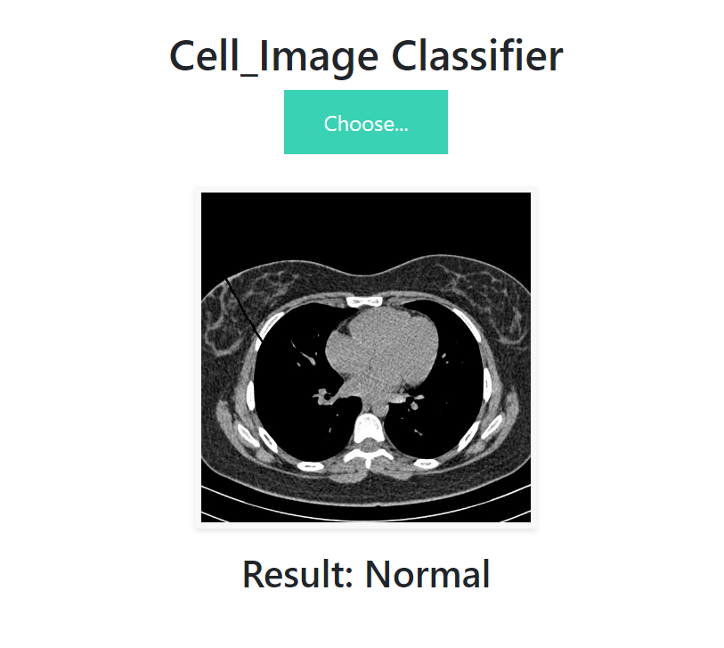
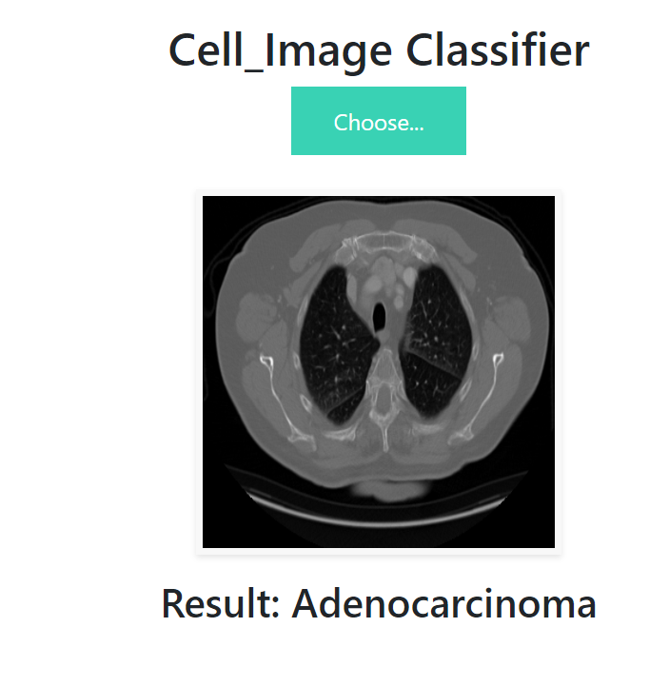
Results

Slide 10
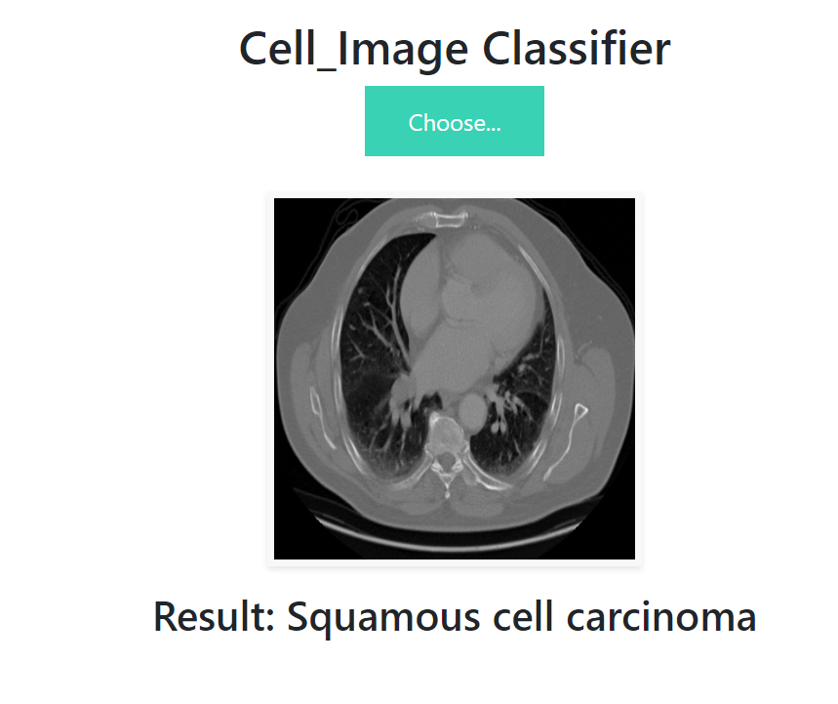
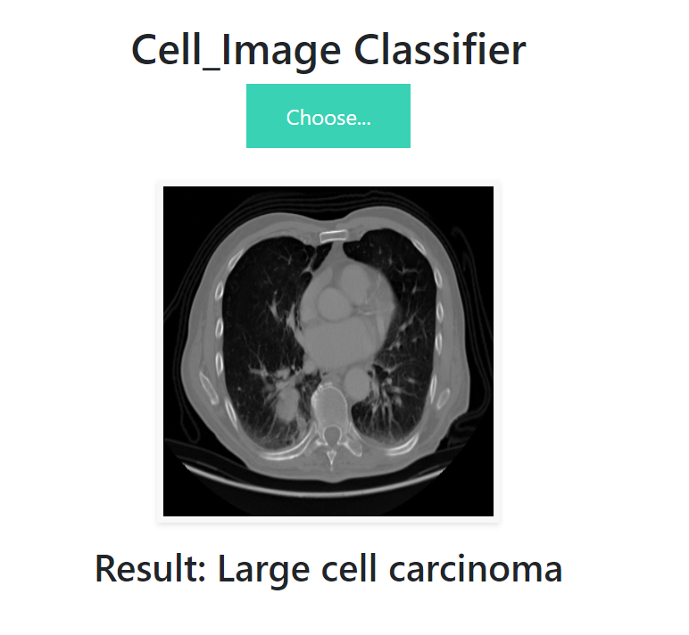
Results

Slide 11
Conclusion
The code demonstrates a training and deploying a CNN model for medical image classification.The Flask web application allows users to interact with the trained model for real-time predictions, which could be useful in a Lung Cancer diagnosis.Our methodology successfully developed automatic lung cancer detection for CT images using texture analysis and CNN. Pre-processing techniques enhance the accuracy of the cancer detection. Results of the proposed methodology are promising with an overall accuracy of 53.96%.

Slide 12

Thank You !

